Slide 1
WELCOME
CONFIGURATION
FOR
ACCOUNTS RECEIVABLE (FI)
Compiled By S.N.HEGDE

Slide 2
Topics
Terms Of Payment
B) Reason Code
C) Default Account Assignment
D) Overall A/R & Employee Tolerance
E) Customer Master Record

Slide 3
Terms of Payment

Slide 4
Terms Of Payment
The Accounts Receivable sub-ledger ( A/R) allows to effectively manage customer accounts and unpaid invoices.
Terms of payment involve the related time frames and discount amount.
The configuration for terms of payment is the same for both A/R and A/P.

Slide 6
Terms Of Payment
You can get to the Terms of Payment configuration screen with the following menu path :
Financial Accounting -> Accounts Receivable and Accounts Payable -> Business Transactions -> Outgoing Invoices / Credit Memos -> Maintain Terms of Payment.
Transaction code: OBB8

Slide 7
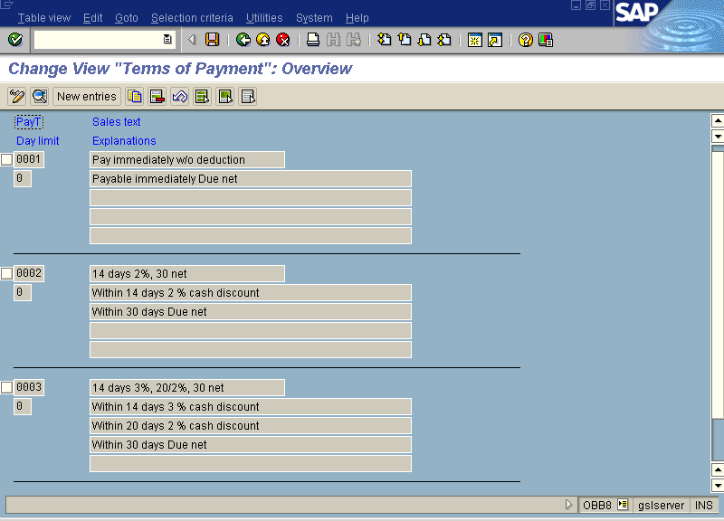

Slide 8
B) REASON CODE

Slide 9
REASON CODE
Reason codes are used to segregate different reasons for underpayment and over payment on A/R line items.
With a reason code, you can define whether the difference should charged off to G/L account or if a residual posting should be made. Residual postings clear the line item being paid and create a new open line item for the difference between the total amount of the line item and the payment amount.

Slide 10
REASON CODE
To get the configuration screen for Creating Reason Code , use following menu path :
Financial Accounting -> Accounts Receivable and Accounts Payable -> Business Transactions -> Incoming Payments -> Payment Receipts Global Settings -> Overpayment / Underpayment -> Define Reason Codes.
Transaction code: OBBE

Slide 11
C) DEFAULT ACCOUNT
ASSIGNMENT

Slide 12
DEFAULT ACCOUNT ASSIGNMENT
Account determination for A/R related transactions such as underpayment /overpayment, cash discount etc. are needed to be done automatically.
Underpayment/ Overpayment are covered by reason code which should determine which G/L account to be posted.
If the company grants cash discount, it is necessary to define the cash discount account that will be used by automatic account assignment

Slide 13
DEFAULT ACCOUNT ASSIGNMENT
To get to the configuration screen for Assigning G/L accounts to Reason Codes, use following menu : Financial Accounting ->Accounts Receivable and Accounts Payable -> Business Transactions -> Incoming Payments -> Payment Receipts Global Settings -> Define accounts for Overpayment / Underpayment.
Transaction code : OBXL

Slide 14
DEFAULT ACCOUNT ASSIGNMENT
To get to the configuration screen for Assigning Cash discounts to G/L accounts, use following menu : Financial Accounting ->Accounts Receivable and Accounts Payable -> Business Transactions -> Incoming Payments -> Payment Receipts Global Settings -> Define Accounts for Cash Discount Granted.
Transaction code :OBXI

Slide 15
OVERALL A/R & EMPLOYEE TOLERANCE
In the configuration of tolerance groups, one can set the maximum amount that employee can clear against a customer account, the maximum cash discount percentage amount that can be applied to a customer’s invoice and the maximum payment difference in percentage terms up to an overall amount.
Further, there is customer tolerance group that can be assigned to a customer master record.

Slide 16
OVERALL A/R & EMPLOYEE TOLERANCE
To get to the configuration screen for Creating Customer Tolerance Group, use following menu : Financial Accounting ->Accounts Receivable and Accounts Payable -> Business Transactions -> Manual Payment Receipt -> Define Tolerance ( Customer).
Transaction Code : OBA3

Slide 17
E) CREDIT MANAGEMENT

Slide 18
CREDIT MANAGEMENT
Credit management is a matter of concern in both FI and SD. There are vital pieces of credit management configuration in both modules.
In FI modules, the activities involved are:
Defining Credit Control Area
Defining Credit Risk Categories.
Creating Credit Representative Groups
Assigning Employees to Credit Rep. Group
Define Days in Arrears Calculation

Slide 19
CREDIT MANAGEMENT
To get to the configuration screen for Creating Credit Control Area, use following menu : Enterprise Structure -> Maintain Structure -> Definition -> Financial Accounting-> Maintain Credit Control
Transaction code : OB45

Slide 20
CREDIT MANAGEMENT
To get to the configuration screen for Defining Credit Risk Categories , use following menu : Financial Accounting ->Accounts Receivable and Accounts Payable -> Credit Management -> Credit Control Account -> Define Risk Categories.
Transaction code : OB01

Slide 21
CREDIT MANAGEMENT
To get to the configuration screen for Creating Representative Group, use following menu : Financial Accounting ->Accounts Receivable and Accounts Payable -> Credit Management -> Credit Control Account ->Define Accounting Clerk Group
Transaction code : OB02

Slide 22
CREDIT MANAGEMENT
You can assign employees to credit representative groups by using following menu:Financial Accounting ->Accounts Receivable and Accounts Payable -> Credit Management -> Credit Control Account ->Define Credit Representative
Transaction code : OB51

Slide 23
CREDIT MANAGEMENT
To get to the configuration screen for Maintaining the Days in Arrears Calculation, use following menu :Financial Accounting ->Accounts Receivable and Accounts Payable -> Credit Management -> Business Transaction: Credit Monitoring -> Define Intervals for Days in Arrears for Credit Management
Transaction code :OB39

Slide 24
E) CRUSTOMER MASTER
RECORD

Slide 25
CUSTOMER MASTER RECORD
Much like G/L vendor master data is combination of configuration and master data maintenance.
A key concept in the configuration of customer master data is customer groups . Customer groups allow to have separate purposes and field statuses for different types.
Different number ranges can be assigned to different customer account groups

Slide 26
CUSTOMER MASTER RECORD
You can get to the Customer Groups configuration screen with the following menu path :
Financial Accounting -> Accounts Receivable and Accounts Payable -> Vendor Accounts -> Master Records -> Preparation for Creating Customer Master Records -> Define Account Groups with Screen Layout (Customers)
Transaction code: OBD2

